Slide 1
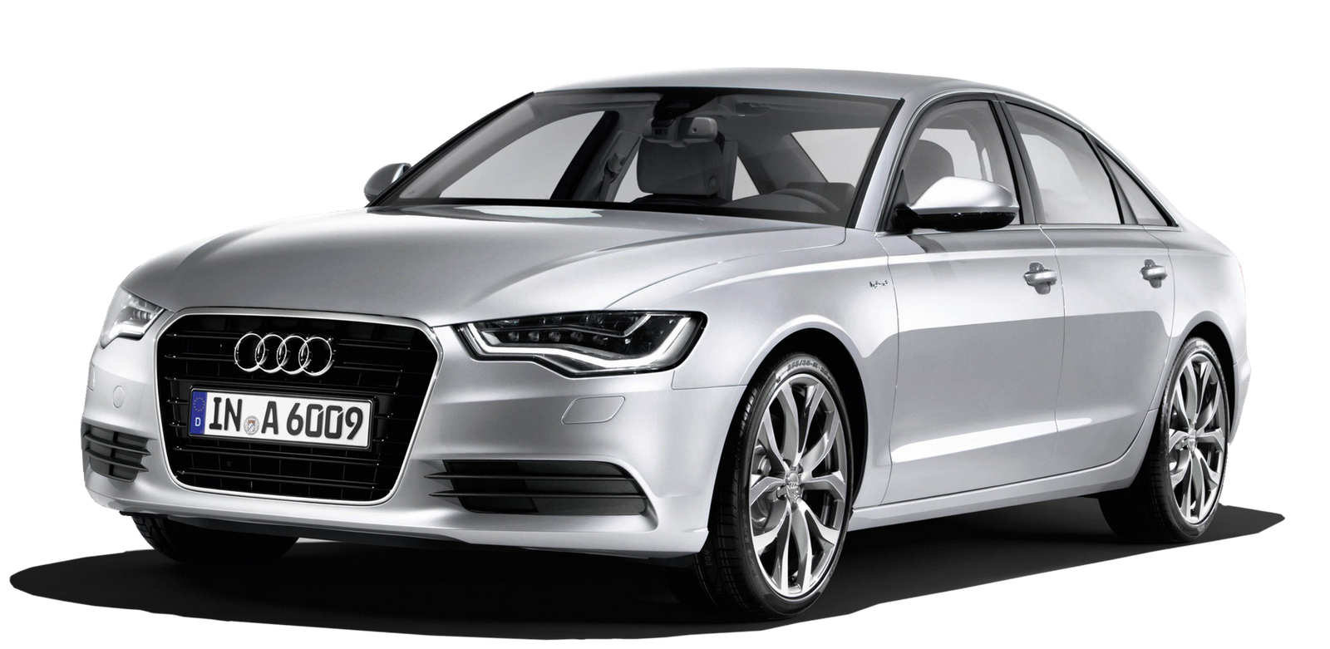
CAR PRICE PREDICTION USING LINEAR REGRESSION MODELLING

Slide 2
Content:
OVERVIEW
WHAT IS CAR PRICE?
DATASET SUMMARY
TECHNOLOGY
METHODOLOGY
VISUALIZATIONS
ARCHITECTURE OF CAR PRICE PREDICTION
CONCLUSION

Slide 3
OVERVIEW
The Car Price Prediction Project aims to develop a Machine Learning model that predicts the selling price of cars based on various features such as brand, model, year, mileage, fuel type, engine size, and more. This Project utilizes historical car data to train and evaluate the model, with the goal of providing accurate price estimates for used cars.
This project aims to create a reliable tool for predicting car prices, assisting both buyers and sellers in making informed decisions in the used car market.

Slide 4
What is car price ?
Car Price refers to the monetary value at which a vehicle is listed or sold in the market. It represents the amount of money that a buyer is expected to pay to purchase the car from the seller.
Car prices can very widely depends upon several factors, include:
1. Brand & Model
2. Year of Manufacture
3. Condition
4. Market Demand & Supply
5. Features & Options
6. Location
7. Fuel Type & Efficiency
8. Warranty & Service History

Slide 5
Dataset summary
The module is used to retrieve the data from online.
This dataset contains the 892 observations.
This data contains the Brand, Model, Year, Mileage, Fuel Type, Price.
Each observation represents a car price between the brand of the car and also based on the fuel type of the car.

Slide 6
TECHNOLOGY
Load and explore the dataset by using the Pandas and using NumPy for numerical computing the mathematical operations.
Matplotlib and Seaborn are the python libraries for the Data Visualization as Plots and Graphs.
Scikit-learn is a popular Machine Learning library in python. It is used for data preprocessing, model building, evaluating the values. Algorithms like Linear Regression, Random Forest Regression, and to find the High Accurate predictions, Handle missing values.
Model Evaluation is a technique like cross-validation, such as Mean Absolute Error (MAE), or Root Mean Squared Error (RMSE) to evaluate the model performance.

Slide 7
methodology
Dataset Collection
Data Pre-processing
Extraction Features
Training Set
Testing Set
Linear Regression Modelling
Error Calculations
Prediction

Slide 8
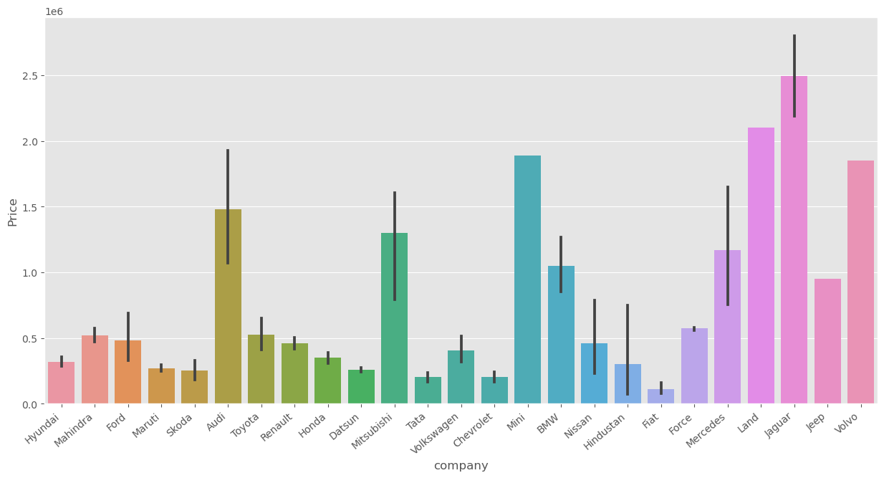
Price range in different Companies
The comparison of Cars, the Jaguar cars have more prices.
There is a record for the particular top branded cars having a limited price in particular duration.

Slide 9
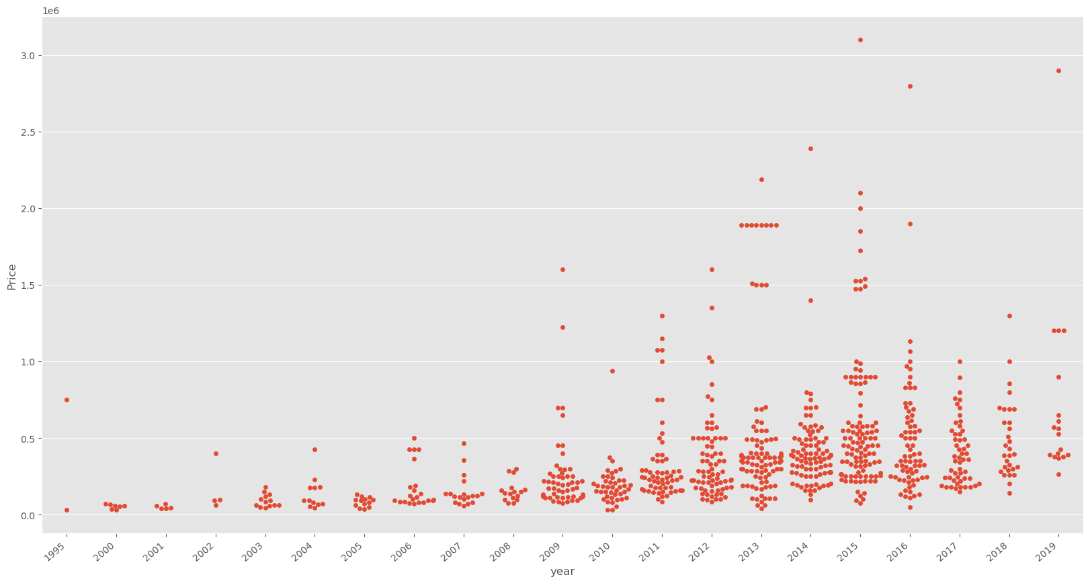
Price range per Year
The Highest price of Cars in the year of 2015.
There is a record for the car price range between the year of 1995 to 2019 in the explored dataset.

Slide 10
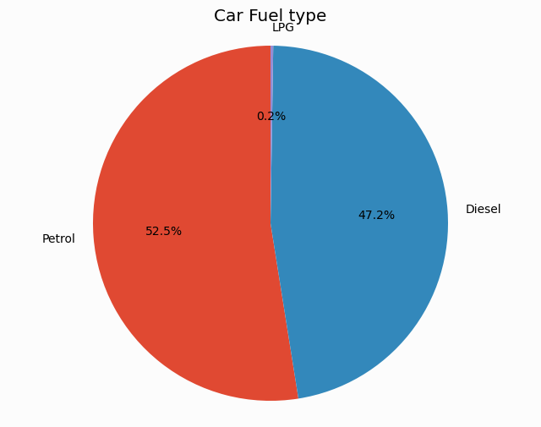
Car Status with the Fuel type
The Listed Cars has used the fuel as Petrol.
A Few counts only use the LPG fuel for cars as 0.2%.

Slide 11
ARCHITECTURE OF CAR PRICE PREDICTION
Data
Cleaning
Data
Pre-processing
Model
Training,
Prediction
and
Evaluation
Start
Data
Collection
Visuals
Conclusion
End
Feature
Engineering
CheckingNull Values
NO
Results
Storage

Slide 12
Conclusion
In this project, a Linear Regression Model was successful to implemented employing various prominent algorithms from the Python libraries and modules.
By using machine learning we can predict the future prices of cars which will be helpful for buyers to buy more conscious.
Linear Regression is one of the best machine learning algorithm for predicting future outcomes and is best suited for the car price prediction.
After the collection of data was done, further processing of data was done. The null entries and missing datapoints were removed from the dataset and the categorical variables were also processed using One-Hot Encoding technique.

Slide 13
THANK YOU !!!!!

